Slide 1
Data Communication and
Networks

Slide 2
PHYSICAL LAYER

Slide 3
Overview
Transmission Media

Slide 4
Transmission Media
Data transmission occurs between transmitter and receiver over some transmission mediators.
Signals are transmitted in the form of electromagnetic energy.
Successful transmission of signals depends principally on two factors.
Quality of the signal being transmitted.
Characteristics of the transmission medium.

Slide 5
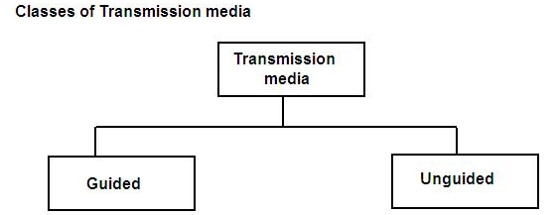

Slide 6
TRANSMISSION MEDIA
GUIDED MEDIA
  Waves are guided along a physical path.
  Signal traveling along any of these media is directed and contained by the physical limits of the medium.
UNGUIDED MEDIA
Transmitting electromagnetic waves but do not guide them.
Air, vacuum, and seawater.

Slide 7
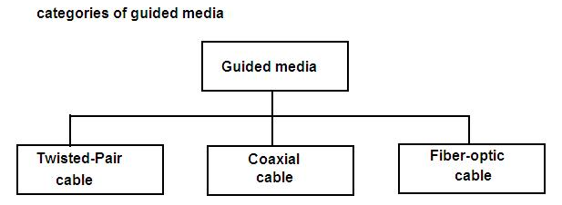

Slide 8
Twisted-Pair Cable
Widely used guided transmission medium.
Mostly use in telephone system, its frequency range is suitable for transmitting both data and voice. It consists of two insulated copper wires arranged in a regular spiral pattern.
Pair acts as a single communication link.
Twist length varies from 5 to 15cm.
Thickness of from 0.4 to 0.9mm.
Twisted pair cable comes in two forms:
Unshielded Twisted pair cable (UTP)
Shielded Twisted pair cable (STP)

Slide 9
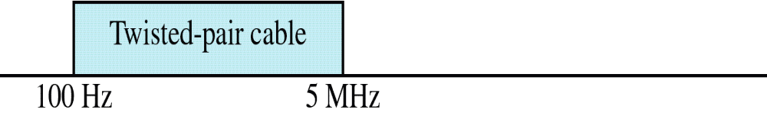
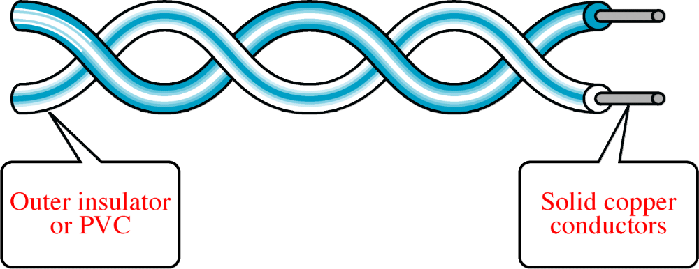
Twisted-Pair Cable

Slide 10
Unshielded Twisted-Pair (UTP) cable
UTP cable is the most common type of telecommunication medium in use.
Its frequency range is suitable for transmitting both voice and data.
Ordinary Telephone wire.
Colored plastic insulation for identification

Slide 11
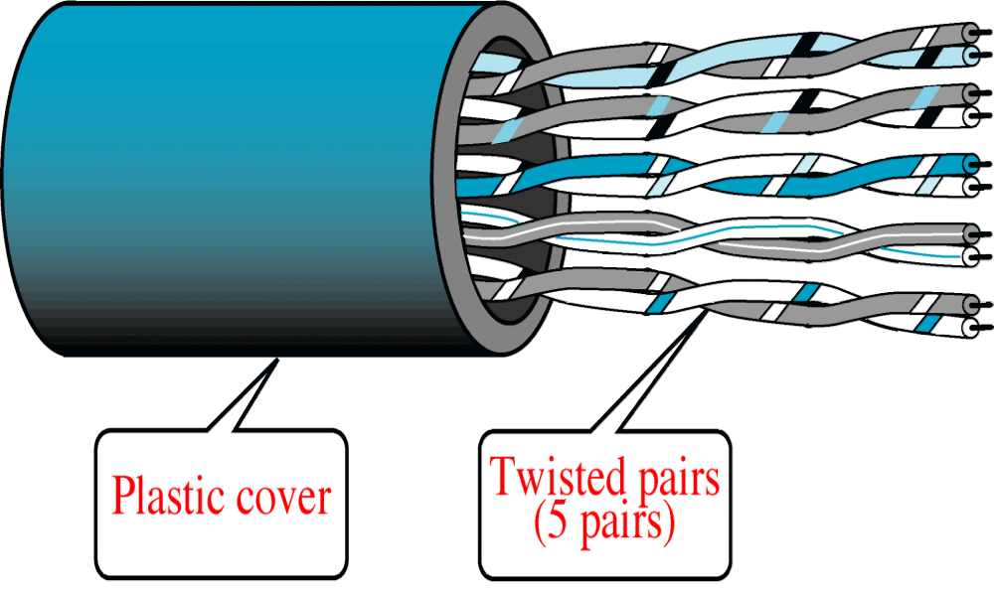
Unshielded Twisted-Pair Cable (UTP)

Slide 12
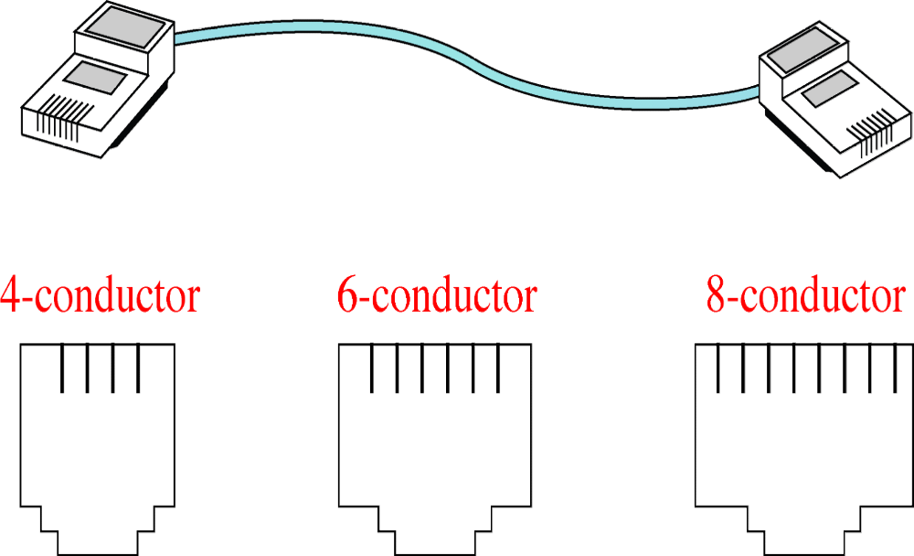
UTP Connectors

Slide 13
Twisting does not always eliminate the impact of noise, but it does significantly reduce it.
Advantages of UTP:
Cheap
Flexible and easy to install.
Electronic Industries Association (EIA) has developed standards to grade UTP cables by quality.
CAT 1, CAT 2 , …… CAT 6

Slide 14
Shielded Twisted-Pair (STP) Cable
STP cable has a metal foil or braided-mesh covering that encases each pair of insulated conductors.
The metal casing prevents the penetration of electromagnetic noise.
It also eliminates cross-talk, which is a undesired effect of one circuit.
STP has the same quality considerations and uses the same connectors as UTP, but the shield must be connected to the ground.
STP is more expensive than UTP but less susceptible to noise.

Slide 15
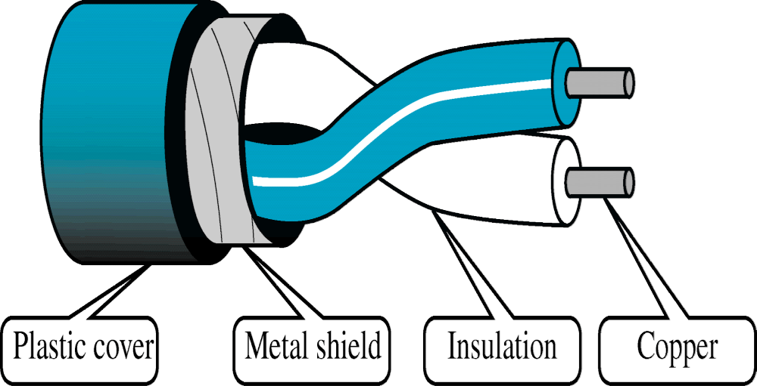
Shielded Twisted-Pair Cable

Slide 16
COAXIAL CABLE
Coaxial (coax) cable carries signals of higher frequency ranges than twisted-pair cable.
Coax has a central core conductor of solid or stranded wire (usually copper) enclosed in an insulation sheath, which is in turn, encased in an outer conductor of metal foil, braid, or a combination of the two.
The outer metallic wrapping serves both as a shield against noise and as the second conductor, which completes the circuit.

Slide 17

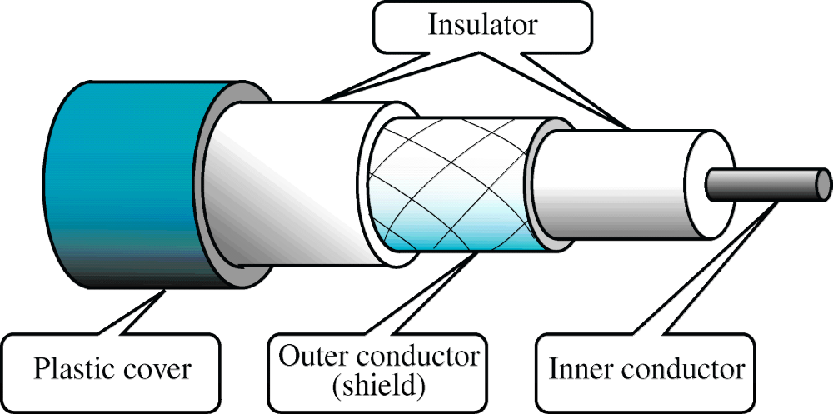
Coaxial Cable

Slide 18
  Standards :
  Different Coaxial cable designs are categorized by their radio government ratings.
  RG number denotes a unique set of physical specifications. It includes
      * Wire gauge of the inner conductor
      * Thickness and type of conductor
      * Constructions of the shield
      * Size and type of the outer casing.

Slide 19
  (50ohm) RG –8 and RG 11 (used in thick Ethernet specification)
  (50ohm) RG –58 (used in this Ethernet specification)
  (75ohm) RG –59 (used in CATV))
  (930ohm) RG –62 (used for ARCNET specification)

Slide 20
  Coaxial Cable Connectors :
  There are different connectors use with coaxial cable
  BNC (bayonet Network connector)
  T connector (used in this Ethernet)
  Terminators (required for bus to topologies)
  (any signal transmitted over the line echoes back and interfaces with the original signal)

Slide 21
Optical Fiber
  Fiber optic cable is made of a light conducting glass of plastic core surrounded by more glass, called cladding , and a tough outer sheath.
  Center are provides the light path or wave guide while the cladding a composed of varying layers of reflective glass.
  The glass cladding is designed to refract light back in to the core.
  Some beams strike the interface of the core and cladding at an angle smaller than the critical angle.
  Transmitting side uses (LED)
  Receiving side (photodiode)

Slide 22
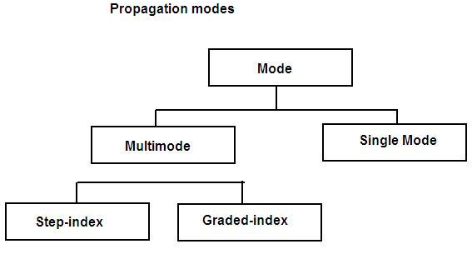
Propagation modes:
Current technology supports two modes for propagating light along channels with different physical characteristics.

Slide 23
  Step-Index fiber :
  Multiple beams from a light source move through the core in different paths.
  Density of the core remains constant from the center to the edges.
  Beam of light move through this constant density in a straight line until it reaches the interface of the core and cladding.
  It refers suddenness of change.
  Some beams in the middle travel in straight lines through the core and reach the destination without reflecting and refracting.
  Expressed in microns (micro meters)

Slide 24
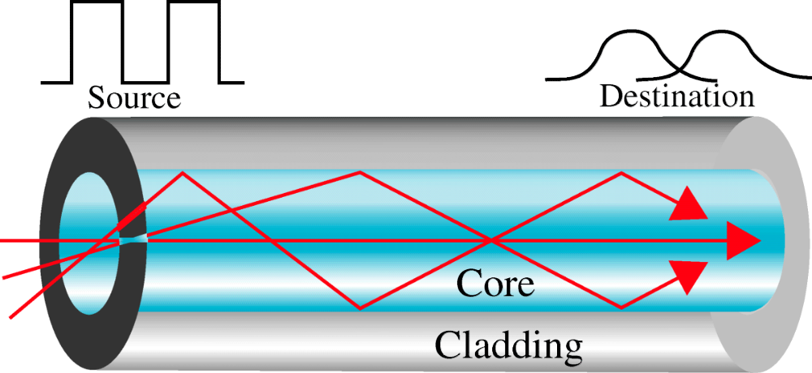
Multimode Step-Index

Slide 25
Multimode Graded – Index fiber:
  Core density decreases with distance from the center)
  Index refers to the index of refraction
  Index of refraction is related to density
  So graded- Index means varying densities
  Density is highest at the center of the core and decreases gradually to its lowest at the edge.

Slide 26
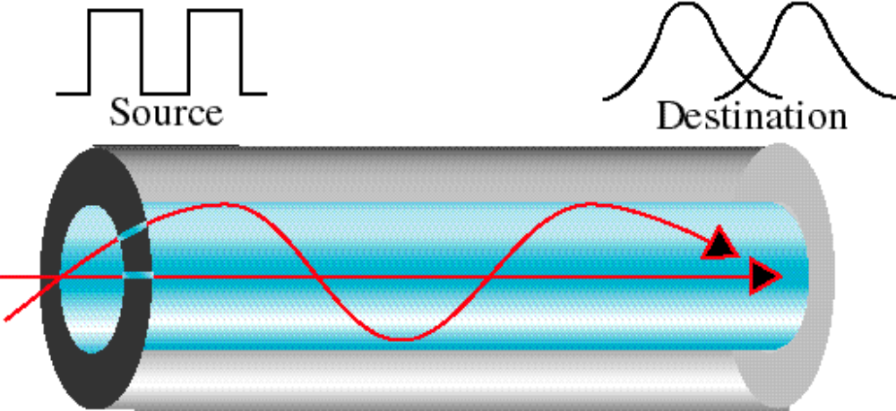
Multimode Graded-Index

Slide 27
Single mode
it uses a step-index fiber.
a highly focused source of light that limits the beam to a small range of angles, all close to the horizontal.
It is manufactured with a much smaller diameter than that of multimode fiber, and with substantially lower density (index of refraction).
The decrease in density results in a critical angle that is close to 90 degrees to make the propagation of beams almost horizontal.
In this case, propagation of different beams is almost identical and the delays are negligible.

Slide 28
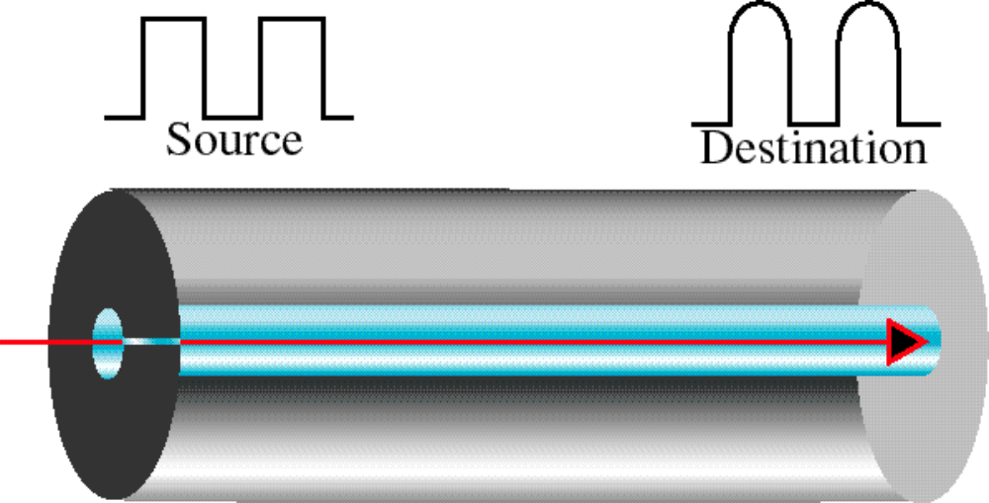
Single Mode

Slide 29
Advantages of Optical fibers
Noise resistance: it uses light for transmission of data, noise is not a factor. External light is blocked by the outer jacket.
Less signal attenuation: fiber-optic transmission distance is significantly greater than other guided media.
Higher bandwidth: they can support higher bandwidth than either twisted-[air or coaxial cables.

Slide 30
Disadvantages of Optical fiber
Cost: they are expensive. Manufacturing must be painstakingly precise. Laser light source costs more.
Installation/maintenance: any roughness or cracking of the core diffuses the light and alters the signal.
Fragility: they easily break than wire, making it less useful for applications were hardware portability is required.

Slide 31
  Wireless Transmission
Unguided media:
  Transmission and reception are achieved by means of an antenna.
  Transport electromagnetic waves without using a physical conductor.
        Signals are broadcast through air, available to anyone who has a device capable of receiving them.
  Transmission: Antenna radiates electromagnetic energy into the medium.
Reception: Antenna picks up electromagnetic waves from the surrounding medium.
Basically 2 type of configurations for wireless transmission:
1) Directional 2) Omni directional

Slide 32
  Directional :
  Transmitting antenna puts out a focused electromagnetic beam so receiver and transmitter antennas must be carefully aligned.
  Omni directional :
  Transmitted Signals spreads out in all directions and can be received by many antennas.

Slide 33
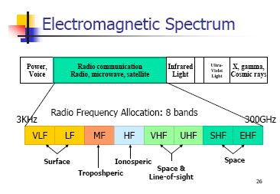
  RF allocation
  Radio communication is divided into 8 ranges called band, each regulated by government authorities.
  Bands are rated from VLF to EHF

Slide 34
  Propagation of Radio Waves:
  Types of propagation :
  Radio wave transmission utilize 5 different types of propagation ionosphere
  i) Surface
  ii) Tropospheric
  iii) Ionospheric
  iv) Line of sight
  v) Space
  Radio technology considers the earth as surrounded by two layers of atmosphere.
  (i) Troposphere : approx. 30 miles from the earth surface.
  (ii) Ionosphere : Layer of atmosphere above the troposphere but below space.

Slide 35
  (i) Surface propagation :
  Radio waves travel through the lowest portion of the atmosphere.
  Lowest frequencies, signals emanate in all directions from the transmitting antenna
  Greater power – greater distance.
  It also taken place in seawater.

Slide 36
  (ii) Tropospheric propagation :
  can work 2 ways
  (i) signal can be directed in a straight line from antenna to antenna (line of sight)
  (ii) It can be broadcast a rectangle into the upper layers of the troposphere, where it is reflected back down to the earths surface. (greater distance to be covered.)
  (iii) Ionospheric propagation :
  Higher frequency radio radiate upward into the ionosphere where they are reflected back to earth

Slide 37
  Density difference between ionosphere and troposphere causes each radio wave to speed up and change direction.
  It covers greater distance with lowered power output.
  (iv) Line - of - Sight:
  Very High frequency signals are transmitted in straight lines directly from antenna to antenna.
  Antenna must be directional, facing each other not to be affected by the an curvature of earth.
  (V) Space Propagation :
  Utilizes satellite relays in place of atmospheric refraction.
  Broadcast signal is received by an orbitary, satellite, which rebroadcast the signal to the under led receiver back on the earth.

Slide 38
  Terrestrial Microwaves :
  most common type of microwave antenna is the porrabolic “dish”
  Size is about 3m in diameter.
  Frequency range from 30ghz to 300ghz
  Do not follow the curvature of the earth.
  So it require line-of-sight transmission and reception equipment.
  Distance coverable by a line-of-sight signal depends on the height (100m) above the ground level to avoid any intervening obstacles.
  Maximum distance between the antenna is
  D = 7.14√ kh
  D = distance between antenna
  K = adjustment factor (k=4/3)
H = antenna height in meter.

Slide 39
  Microwave signals propagate in one direction at a time
  So it means that 2 frequencies are necessary for two way communication, such as telephone conversation.
  So each frequency requires own transmitter and receiver.
  Today available with single piece called transceiver.
  Repeaters : To covers more distance
  Antenna : Two types of antenna are used for terrestrial
  (i) Parabolic dish
  (ii) Horn.

Slide 40
  Satellite :
  Transmission is much like line-of-sight microwave transmission
  Here one of the station is a satellite orbiting the earth
  Principal is some as terresterial, with a satellite acting as a supertall antenna and repeater.
  Satellite receiver transmission on one frequency band (uplenth), amplifier or repeats the signal, and transmit it on another frequency (downlink)
  Signal must travel in straight lines.
  Signal orbiting satellite will operate on a number of frequency bands called transponders.

Slide 41
  Two common configurations for satellite communication.
  (i) point-to-point
  (ii) broadcast link
  Advantages :
  Makes high-quality communication available to any undeveloped parts of the world.

Slide 42
  Geo Synchronous Satellites :
  Line-of-sight transmission requires that the sending and receiving antenna be locked onto each other’s location at all times.
  For this reason, satellite that moves faster or slower than earth rotation is useful only for short periods of time.
  To ensure constant communication, the satellite must move at the same speed as the earth. (it remains stationary above a certain spot.)
  Such satellites are called as geosynchronous.
  Appilication:
  (i) TV distributes
  (ii) Long distinct tele transmission
  (iii) Private business networks.

Slide 43
  Application:
  There are no of business data application for satellite.
  Video the total capacity into no of channel and lease these channel to individual business users.
  Recent development is VSAT (very small aperture terminal)
  Broad cast radio
  The principal difference between microwave and satellite is
  Frequencies in the range from 3khz to 300ghz
  To cover VHF and part of UHF

Slide 44
  Cellular Telephony :
  To provide stable connection between two moving devices or between one mobile unit and on stationary
  Service provider must be able to locate and track a caller, assign a channel to the call.
  It also transf4er signal from channel to channel as the caller moves out of range of one channel and into the range of another.
  For easy to tracking, service area is divided into cell.
  Each cell contains antenna and is controlled by a small office, called cell office.
  Each cello office is controlled by a switching office (MTSO).
  It has co-ordinate communication between cell office and telephone central office.

